Slide 1
KSC6103: Data Structure & Algorithm
Topic 9: Hashing

Slide 2
Chapter Outline
Introduction of Hashing
Advantages
Hashing Function
Hashing Table
Collision Resolution Techniques
Separate Chaining
Linear Chaining
Quadratic Probing
Double Hashing
Application

Slide 3
Introduction of Hashing
Hashing is a technique that is used to uniquely identify a specific object form a group of similar objects:
Some examples of how hashing is used in our lives include:
In universities, each student is assigned a unique roll number that can be used to retrieve information about them.
In libraries, each book is assigned a unique number that can be used to determine information about the book
In both these examples the students and books were hashed to a unique number.
Assume that you have an object and you want to assign a key to it to make searching easy. To store the key/value pair, you can use a simple array like a data structure where keys (integers) can be used directly as an index to stire values. However, in cases where the keys are large and cannot be used directly as an index, you should use hashing

Slide 4
Introduction of hashing
Hashing is implemented in two steps:
An element is converted into an integer by using a hash function. This element can be used as an index to store the original element, which falls into the hash table.
The element is stored in the hash table where it can be quickly retrieved using hashed key.
hash = hashfunc(key)
index = hash % array_size

Slide 5
Advantages
The main advantage of hash tables over other table data structures is speed.
The advantage is more apparent when the number of entries is large (thousands or more)
Hash tables are particularly efficient when the maximum number of entries can be predicted in advance, so that the bucket array can be allocated once with the optimum size and never resized

Slide 6
Hash function
A hash function is any function that can be used to map a data set of an arbitrary size to a data set of a fixed size, which falls into the hash table.
The values returned by a hash function are called hash values, hash codes, hash sums, or simply hashes.
A hash function is any function that can be used to map a data set of an arbitrary size to a data set of a fixed size, which falls into the hash table.
The values returned by a hash function are called hash values, hash codes, hash sums, or simply hashes.
To achieve a good hashing mechanism, it is important to have a good hash function with the following basic requirements:
Easy to compute
Uniform distribution
Less collision

Slide 7
Hash table
A hash table is a data structure that is used to store keys/value pairs. It uses a hash function to compute an index into an array in which an element will be inserted or searched.
By using a good hash function, hashing can work well. Under reasonable assumptions, the average time required to search for an element in hash table is O(1).

Slide 8
Collision resolution techniques

Slide 9
Separate Chaining (Open Hashing)
Separate chaining is one of the most commonly used collision resolution techniques
It is usually implemented using linked list. In separated chaining, each element of the hash table is a linked list.
To store an element in the hash table you must insert it into specific linked list.
If there is any collision (i.e. two different elements have same hash value) then store both the elements in the same linked list.

Slide 10
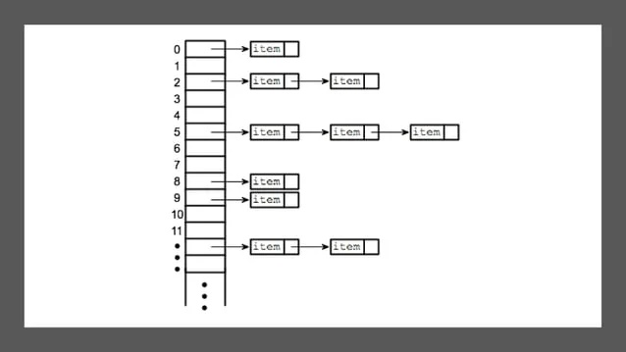

Slide 11
Linear probing
In open addressing, instead of in linked lists, all entry records are stored in the array itself.
When a new entry has to be inserted, the hash index of the hashed value is computed and then the array is examined (starting with the hashed index).
If the slot at hashed index is unoccupied, then the entry record is inserted in slot at the hashed index else it proceeds in some probe sequence until it finds an unoccupied slot.

Slide 12
Linear probing
Linear probing is when the interval between successive probes is fixed (usually to 1). Let’s assume that the hashed index for a particular entry is index. The probing sequence for linear probing will be:
index = index % hashTableSize
index = (index + 1) % hashTableSize
index = (index + 2) % hashTableSize
index = (index + 3) % hashTableSize

Slide 13
Quadratic Probing
Quadratic probing is similar to linear probing and the only difference is the interval between successive probes or entry slots.
Here, when the slot at a hashed index for an entry record is already occupied, you must start traversing until you find an unoccupied slot.
The interval between slots is computed by adding the successive value of an arbitrary polynomial in the original hashed index.

Slide 14
Quadratic Probing
Let us assume that the hashed index for an entry is index and at index there is an occupied slot. The probe sequence will be as follows:
index = index % hashTableSize
index = (index + 1^2) % hashTableSize
index = (index + 2^2) % hashTableSize
index = (index + 3^2) % hashTableSize

Slide 15
Double hashing
Double hashing is similar to linear probing and the only difference is the interval between successive probes. Here, the interval between probes is computed by using two hash functions
Let us say that the hashed index for an entry record is an index that is computed by one hashing function and the slot at that index is already occupied. You must start traversing in a specific probing sequence to look for an unoccupied slot. The probing sequence will be:
index = (index + 1*indexH) % hashTableSize;
index = (index + 2*indexH) % hashTableSize;

Slide 16
Application
Associative arrays: Hash tables are commonly used to implement many types of in-memory tables. They are used to implement associative arrays (arrays whose indices are arbitrary strings or other complicated objects)
Database indexing: Hash tables may also be used as disk-based data structures and
Caches:
Object representation:
Hash functions are used in various algorithms to make their computing faster.

